Slide 1

Coding Environment
Install and Setup

Slide 2
Django
An IDE is an Integrated Development Environment.
Larger software where you can code but also has many integrations (e.g. .NET apps, Source Control).
An Editor allows you to open and edit files.
Lighter weight program that opens and supports editing of files.

Slide 3
Django
Choosing an IDE or Editor is highly personal and there are many, many options available!
NOTE:
Please feel free to use any IDE or editor you prefer and feel comfortable with!

Slide 4
Django
IDE or Editor Common Options:
PyCharm
Atom
Sublime Text Editor
Microsoft Visual Studio
Important Note:
Notebook based editors like Jupyter won’t work for Django!

Slide 5
Django
IDE for Django should ideally have:
Syntax Highlighting Support for multiple languages (HTML, CSS, Python).
Command Line Interface.
Nice to haves:
Highly Customizable Styling and Themes
Web Browser in Editor

Slide 6
Django
For this course we will use the free version of Microsoft Visual Studio Code.
Note:
This is different than “Microsoft Visual Studio”!

Slide 7
Django
Microsoft Visual Studio Code
Free
Cross-Platform (Windows, MacOS, Linux)
Customizable
Supports Multiple File Types

Slide 8
Django
Let’s download it at:
https://code.visualstudio.com/

Slide 9
Introduction to
Django Framework

Slide 10
Django
Let’s have a brief review:
What is Django Framework?
Why use Django?
Pros and Cons of Django
Who uses Django?
Afterwards we’ll have a separate lecture on how the Django Framework works.

Slide 11
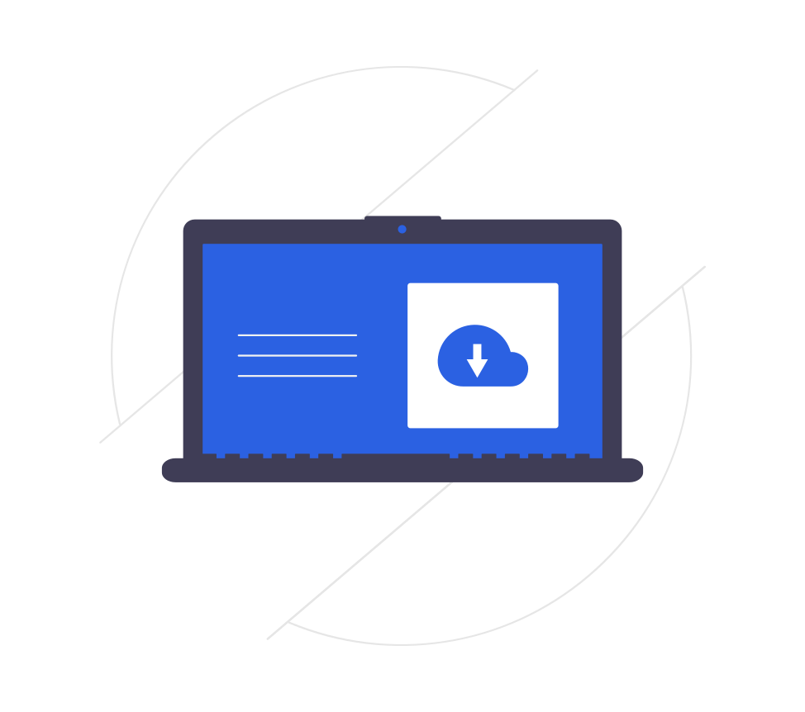
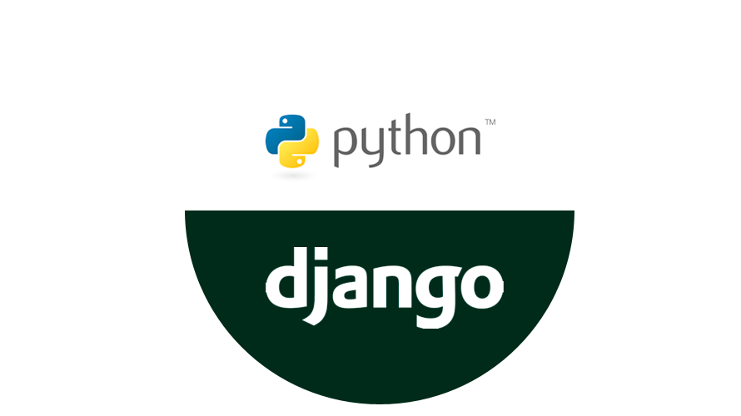
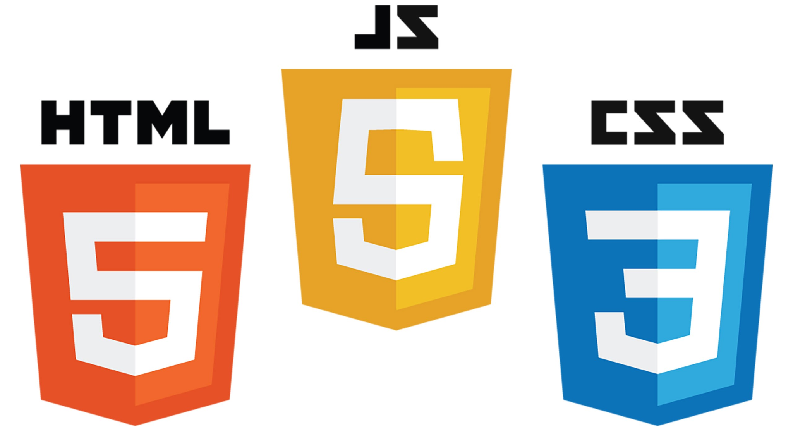
Django
Website Process Review
Front End
Back End

Slide 12
Django
Website Process Review
Front End
Back End

Slide 13
Django
What is Django?

Slide 14
Django
What is Django?
Created by Adrian Holovaty and Simon Willison in 2003 when they worked at the Lawrence Journal-World newspaper.
Released under BSD license in 2005 and in 2008 the non-profit Django Software foundation was created.

Slide 15
Django
What is Django?
Take note of the fact that this project was started at a newspaper!
This has created a culture of very good online documentation for Django!
www.djangoproject.com

Slide 16
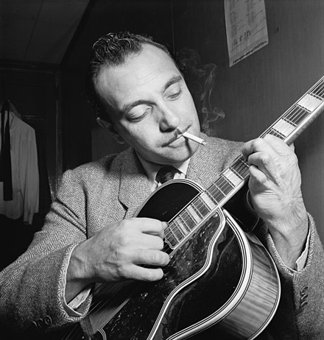
Django
What is Django?
Named after Django Reinhardt

Slide 17
Django
What is Django?
Python based framework for creating web applications.
Framework provides rules, structures, and functionality that allows us to use Python code and libraries on the back end of our web application.

Slide 18
Django
What is Django?
Python is the programming language used to work with Django.
Django can then interact with our web applications to send information to the user of the web application.

Slide 19
Django
Why use Django?

Slide 20
Django
Why use Django?
Key Features:
Allows for fast development.
Many common features included.
Updated often and secure.
Very scalable.
Very versatile with Python.

Slide 21
Django
Why use Django?
You may have heard Django has “batteries included” or is “fully loaded”.
This just means that is has a lot of built in Python modules that take care of really common web application features.

Slide 22
Django
Why use Django?
Lots of built-in functionality:
Administration
Authentication
Database Interaction
Security

Slide 23
Django
Why use Django?
One of the most important aspects of is that since it uses Python as its programming language, we get to use all the cool Python libraries available to use easily within Django!

Slide 24
Django
Why use Django?
For example, if your favorite data analysis tool uses Python, we can easily integrate it into our code with the Django framework.
This allows us to expand Python based projects to become user interactive web applications.

Slide 25
Django
Django Pros:
Lots of features already built-in.
Built with Python.
Scalable, versatile, and secure.

Slide 26
Django
Django Cons:
Since it has so many features, there is sometimes a bit of a steep learning curve.
It may include many features you don’t intend on using.
Built with Python.

Slide 27
Django
Who uses Django?
Instagram
Spotify
YouTube
Pinterest
DropBox
EventBrite
and many more!

Slide 28
Django
We’ve only briefly given you an overview of the Django Framework.
In the next lecture, let’s dive into the specific details of how this Framework is designed, which will relate highly to the upcoming sections in which we learn about these core components!

Slide 29
How Django Works

Slide 30
Django
Let’s discuss the key ideas behind how the Django Framework works.
This will also lead to a nice roadmap of our learning journey for the rest of the course!

Slide 31
Django
Key Features of Django:
Model-Template-View (MTV) Structure
ORM - Object-relational Mapper
Models
URLs and Views
Templates

Slide 32

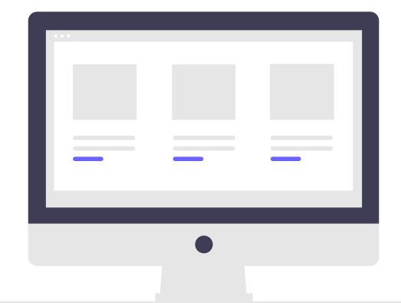
Django
User Browser
Database

Slide 33
Django
User Browser
Database
Template

Slide 34
Django
HTML
CSS
JS
User Browser
Database
Template

Slide 35
Django
HTML
CSS
JS
{{JINJA}}
User Browser
Database
Template

Slide 36
Django
HTML
CSS
JS
{{JINJA}}
User Browser
Database
Template
Python File
Using Django
View

Slide 37
Django
Python File
with
URL Routing
HTML
CSS
JS
{{JINJA}}
User Browser
Database
Template
Python File
Using Django
View

Slide 38
Django
Python File
with
URL Routing
HTML
CSS
JS
{{JINJA}}
Python File
Using Django Models
User Browser
Database
Models
Template
Python File
Using Django
View

Slide 39
Django
Python File
with
URL Routing
HTML
CSS
JS
{{JINJA}}
Python File
Using Django Models
User Browser
Database
Models
Template
Python File
Using Django
View

Slide 40
Django
CLIENT SIDE
SERVER SIDE
Python File
with
URL Routing
HTML
CSS
JS
{{JINJA}}
Python File
Using Django Models
User Browser
Database
Models
Template
Python File
Using Django
View

Slide 41
Django
MODEL
Python File
with
URL Routing
HTML
CSS
JS
{{JINJA}}
Python File
Using Django Models
User Browser
Database
Models
Template
Python File
Using Django
View

Slide 42
Django
TEMPLATE
MODEL
Python File
with
URL Routing
HTML
CSS
JS
{{JINJA}}
Python File
Using Django Models
User Browser
Database
Models
Template
Python File
Using Django
View

Slide 43
Django
VIEW
TEMPLATE
MODEL
Python File
with
URL Routing
HTML
CSS
JS
{{JINJA}}
Python File
Using Django Models
User Browser
Database
Models
Template
Python File
Using Django
View

Slide 44
Django
Python File
with
URL Routing
HTML
CSS
JS
{{JINJA}}
Python File
Using Django Models
User Browser
Database
Models
Template
Python File
Using Django
Application
Logic
in Python
View

Slide 45
Django
Python File
with
URL Routing
HTML
CSS
JS
{{JINJA}}
Python File
Using Django Models
User Browser
Database
Models
Template
Python File
Using Django
Application
Logic
in Python
View

Slide 46
Django
Python File
with
URL Routing
HTML
CSS
JS
{{JINJA}}
Python File
Using Django Models
User Browser
Database
Models
Template
Python File
Using Django
Application
Logic
in Python
View

Slide 47
Django
Python File
with
URL Routing
HTML
CSS
JS
{{JINJA}}
Python File
Using Django Models
User Browser
Database
Models
Template
Python File
Using Django
Application
Logic
in Python
View

Slide 48
Django
Python File
with
URL Routing
HTML
CSS
JS
{{JINJA}}
Python File
Using Django Models
User Browser
Database
Models
Template
Python File
Using Django
Application
Logic
in Python
View

Slide 49
Django
Django structure will also have many more features not shown in this MTV diagram, such as authentication and administration access.

Slide 50
Django
Django Drawbacks?

Slide 51
Django
Django Drawbacks:
Heavily reliant on idea of Model.
The model is a Python/Django representation of a table in a database.
This makes it very easy to work with querying data, but does add the requirement of understanding Models and setting them up for views.

Slide 52
Django
Let’s continue our understanding of Django by beginning to learn about these key components separately and then slowly adding on complexity to a fully functioning website!

Slide 53
First Django Project

Slide 54
Django
Let’s explore how to launch a project with Django.
This is done easily at the command prompt with the django-admin tool.
Django will automatically create a set of subdirectories and files for us.

Slide 55
Django
At the command prompt, navigate to your desired location and type:
django-admin startproject my_site

Slide 56
Django
At the command prompt, navigate to your desired location and type:
django-admin startproject my_site
Special command installed by django. Many sub-commands can be called from django-admin.

Slide 57
Django
At the command prompt, navigate to your desired location and type:
django-admin startproject my_site
Subcommand to create a new project directory.
Automatically creates a set of directories used in most Django projects.

Slide 58
Django
At the command prompt, navigate to your desired location and type:
django-admin startproject my_site
Your chosen name for the project and top level project directory. Feel free to call this anything you want, but use common sense!

Slide 59
Django
This creates the following files and folders:
my_site
my_site
manage.py

Slide 60
Django
This creates the following files and folders:
my_site
my_site
manage.py

Slide 61
Django
This creates the following files and folders:
my_site
my_site
manage.py

Slide 62
Django
This creates the following files and folders:
my_site
my_site
manage.py

Slide 63
Django
my_site
my_site
__init__.py
settings.py
urls.py
asgi.py
wsgi.py
manage.py

Slide 64
Django
my_site
my_site
__init__.py
settings.py
urls.py
asgi.py
wsgi.py
manage.py

Slide 65
Django
my_site
my_site
__init__.py
settings.py
urls.py
asgi.py
wsgi.py
manage.py

Slide 66
Django
my_site
my_site
__init__.py
settings.py
urls.py
asgi.py
wsgi.py
manage.py

Slide 67
Django
my_site
my_site
__init__.py
settings.py
urls.py
asgi.py
wsgi.py
manage.py

Slide 68
Django
Let’s run this ourselves and create our first Django Project!

Slide 69
Django Applications

Slide 70
Django
Django Projects can have separated components called “apps”.
Don’t get confused by this nomenclature!
Typically a “web app” describes the full website or mobile application on the web.
A “Django app” is a sub-component of a single Django Project (web application).

Slide 71
Django
Often it becomes much easier to organize your code through the use of apps.
Each app should cover a different key functionality for your website.
Also keep in mind that if you’re beginning as a solo developer with a simple website, it may make more sense to put everything under a single Django app.

Slide 72
Django
Django Project Structure
Django Project

Slide 73
Django
Django Project Structure
Django Project
App 1

Slide 74
Django
Django Project Structure
Django Project
App 1
App 2

Slide 75
Django
Django Project Structure
Django Project
. . . . . .
App 1
App 2
App N

Slide 76
Django
Django Project Structure
Social Network Website Project

Slide 77
Django
Django Project Structure
Social Network Website Project
Messages
App
Photos
App
Video
App

Slide 78
Django
To create a new app, we use the manage.py file created by the project:
python manage.py startapp app_name
Calls the manage.py file to run a command line execution.

Slide 79
Django
To create a new app, we use the manage.py file created by the project:
python manage.py startapp app_name
Specific command to run from manage.py file.

Slide 80
Django
To create a new app, we use the manage.py file created by the project:
python manage.py startapp app_name
Custom name for app, feel free to change so its relevant to scope of application.

Slide 81
Django
Let’s create an example app and explore how to connect it to a URL view.
That will conclude this section and we’ll revisit all of this in the new section by starting a new project from scratch.

Slide 82
Django
To create a new app, we use the manage.py file created by the project:
python manage.py startapp app_name

Slide 83
Django
Django Project
my_site

Slide 84
Django
Django Project
my_site
settings.py
admin.py
urls.py

Slide 85
Django
Django Project
my_site
settings.py
admin.py
urls.py

Slide 86
Django
Django Project
my_site
settings.py
admin.py
urls.py

Slide 87
Django
Django Project
.......
my_site
settings.py
admin.py
urls.py
APP
ONE
APP
TWO
APP
N

Slide 88
Django
Django Project
my_site
settings.py
admin.py
urls.py
my_app

Slide 89
Django
Django Project
my_site
settings.py
admin.py
urls.py
my_app

Slide 90
Django
Django Project
my_site
settings.py
admin.py
urls.py
my_app
views.py

Slide 91
Django
Django Project
my_site
settings.py
admin.py
urls.py
my_app
views.py

Slide 92
Django
Django Project
my_site
settings.py
admin.py
urls.py
my_app
views.py
urls.py

Slide 93
Django
Django Project
my_site
settings.py
admin.py
urls.py
my_app
views.py
urls.py

